Slide 1
Coundon Primary
YEAR 4 MATHS- HOME LEARNING
Week beginning 15.06.2020

Slide 2
Year 4 – Summer Block – Money
Lesson 1: Using Rounding to Estimate Money

Slide 3
Introduction
Round each number to the nearest 100 and match
it to the number line.
851
126
575
386
100 | 200 | 300 | 400 | 500 | 600 | 700 | 800 | 900
164
849
270
548
655

Slide 4
Introduction
Round each number to the nearest 100 and match
it to the number line.
164
386
575
849
100 | 200 | 300 | 400 | 500 | 600 | 700 | 800 | 900
126
270
548
655
851
© Classroom Secrets Limited 2018

Slide 5
Varied Fluency 1
Which whole pounds does the given amount come in between?
Round the amount to the nearest pound.
£8.00
£7.82
£7.00
£8.00

Slide 6
Varied Fluency 2
Match the amounts to the letters on the number line.
A
B
C
£5
£6
£5.95
559p
£5.05

Slide 7
Varied Fluency 2
Match the amounts to the letters on the number line.
A
B
C
£5
£6
£5.95 | C
559p | B
£5.05 | A

Slide 8
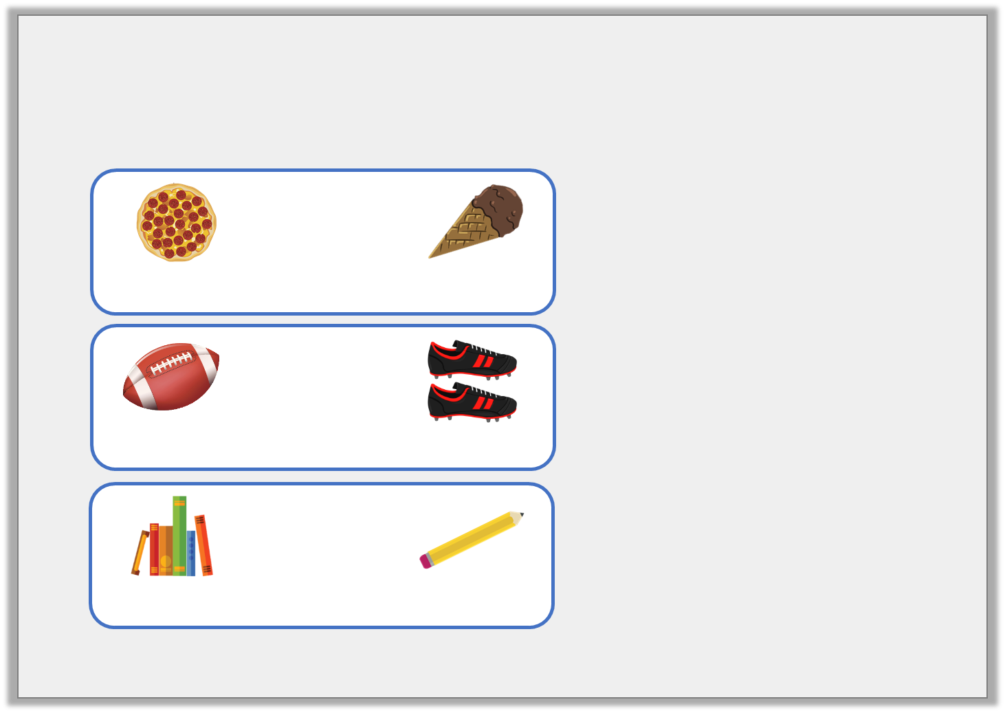
Varied Fluency 3
Match the items to the rounded totals.
 | +
468p |  | £1.67
£4.00
£7.00
£9.00
 | +
225p |  | £6.89
 | +
£3.44 |  | 72p

Slide 9
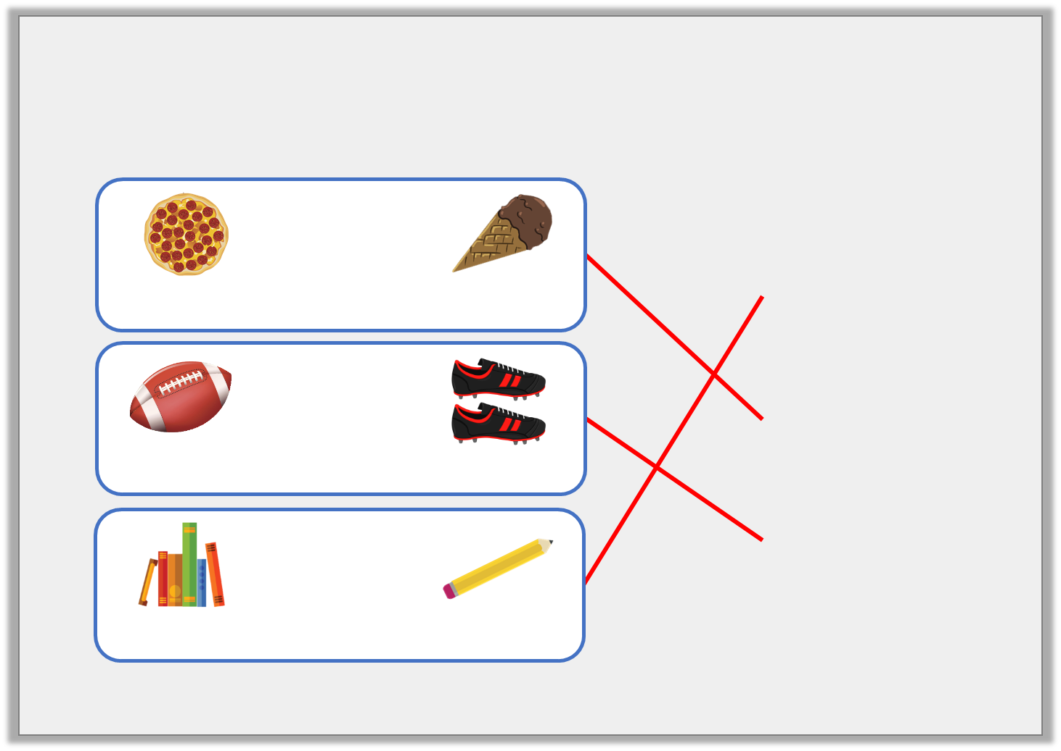
Varied Fluency 3
Match the items to the rounded totals.
 | +
468p |  | £1.67
£4.00
£7.00
£9.00
 | +
225p |  | £6.89
 | +
£3.44 |  | 72p

Slide 10
Varied Fluency 4
James wants to buy a pair of shorts for £4.54
and a t-shirt for £5.28.
What does each amount round to?
He has £12.00.
How much change will he receive approximately?

Slide 11
Varied Fluency 4
James wants to buy a pair of shorts for £4.54
and a t-shirt for £5.28.
What does each amount round to?
£5.00 and £5.00
He has £12.00.
How much change will he receive approximately?
£12 – £10 = £2.00

Slide 12
Reasoning 1
What amount could the arrow be pointing to?
Explain why.
500p
600p

Slide 13
Reasoning 1
What amount could the arrow be pointing to?
Explain why.
The arrow is pointing to less than a quarter of the way along the number line, so the amount must be less than…
500p
600p

Slide 14
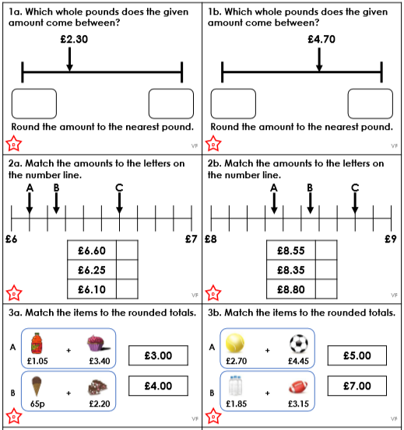
Task - clouds

Slide 15
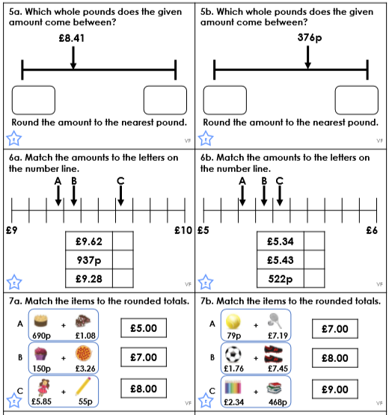
Task - Moons

Slide 16
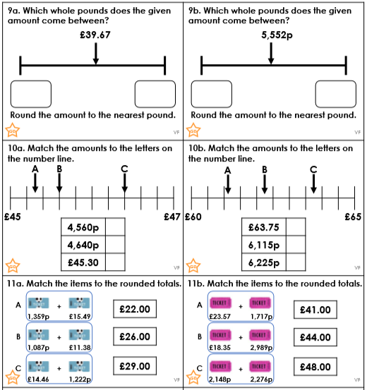
Task - Stars

Slide 17
Year 4 – Summer Block – Money
Lesson 2: Four Operations with money.

Slide 18
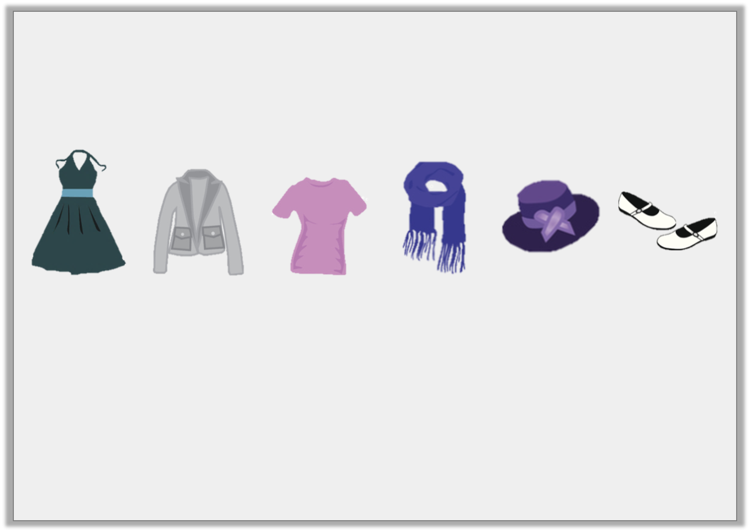
Introduction
Lana is shopping.
She has about £20 to spend.
Estimate what she could purchase.
Dress
£11.45
Jacket
£5.75
Shirt
£7.30
Scarf
£8.55
Hat
£4.95
Shoes
£6.80

Slide 19
Introduction
Lana is shopping.
She has about £20 to spend.
Estimate what she could purchase.
Dress
£11.45
Jacket
£5.75
Shirt
£7.30
Scarf
£8.55
Hat
£4.95
Shoes
£6.80
There are several possible combinations that, when estimated, will cost £20. For example, she could purchase:
the dress and the scarf (£11 + £9 = £20)
the jacket, shirt and shoes (£6 + £7 + £7 = £20)
the hat, jacket and scarf (£5 + £6 + £9 = £20)

Slide 20
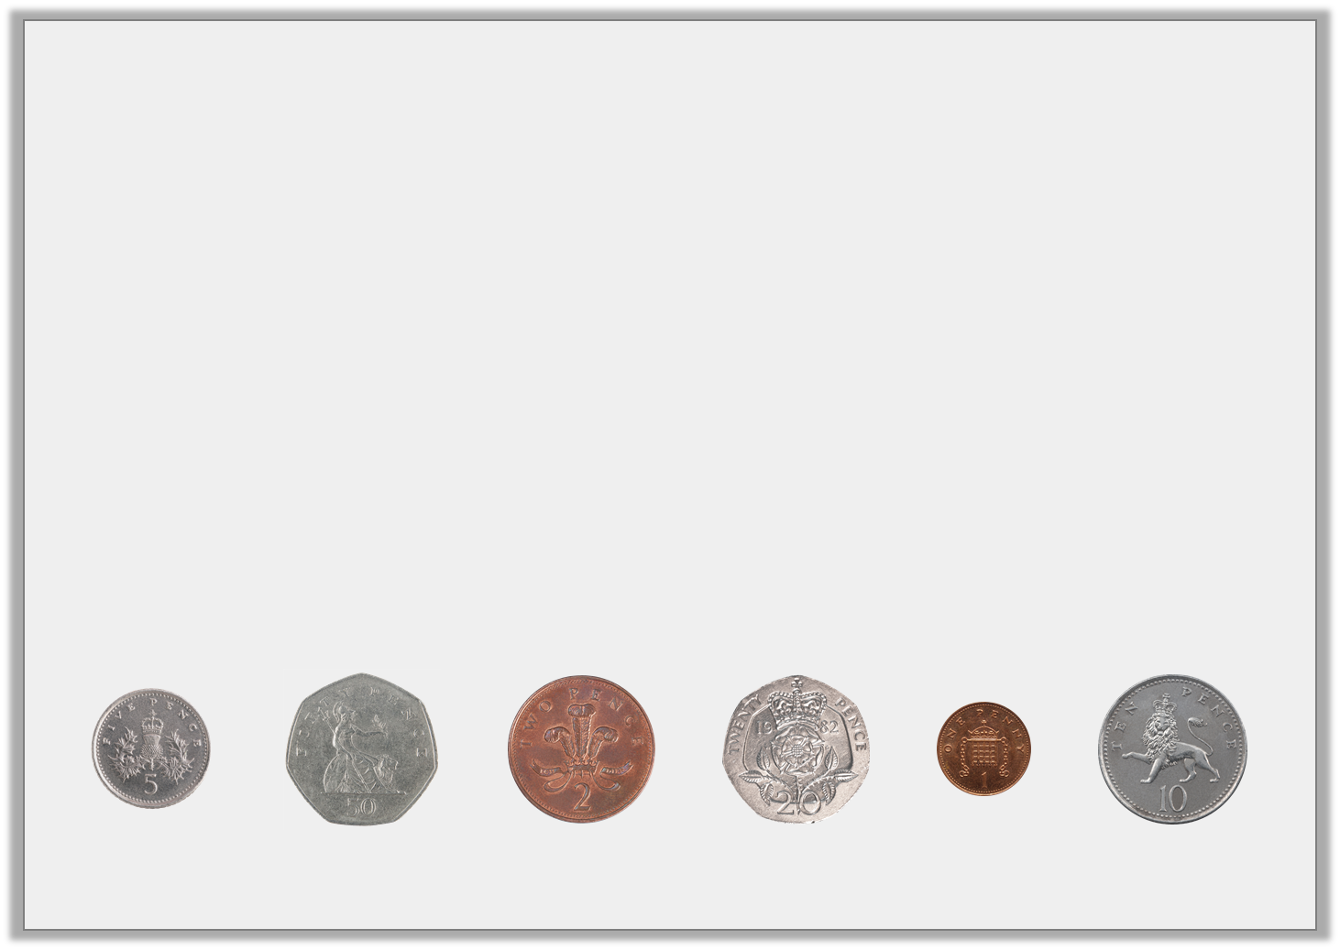
Varied Fluency 1
Which coins would complete this bar model?
You can use coins more than once.
£1.60

Slide 21
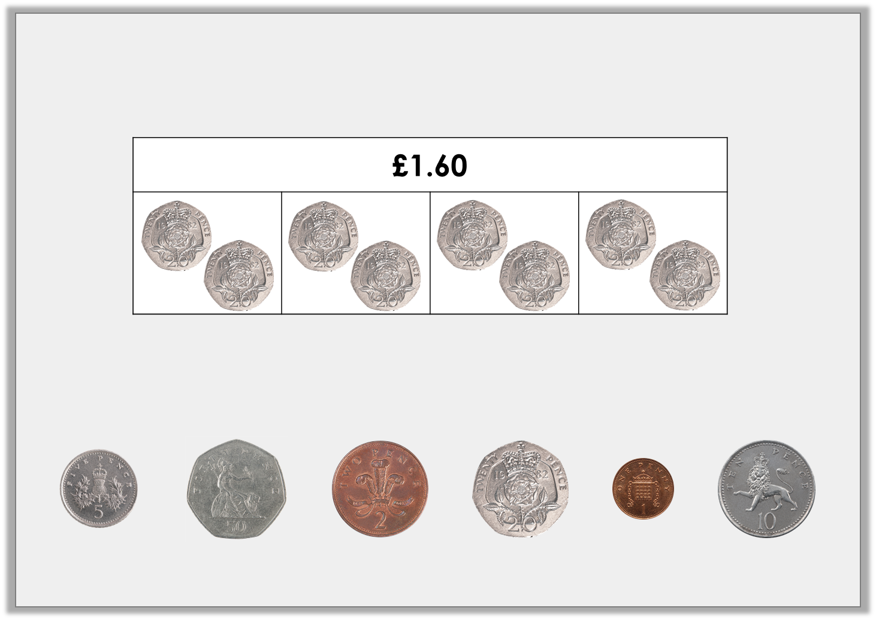
Varied Fluency 1
Which coins would complete this bar model?
You can use coins more than once.
Possible answer

Slide 22
Varied Fluency 2
Complete the bar model for the problem.
Bobby goes to the shopping centre. He spends £12.50 on a new pair of shorts and £10.80 on a t-shirt.
How much money does he spend altogether?

Slide 23
Varied Fluency 2
Complete the bar model for the problem.
Bobby goes to the shopping centre. He spends £12.50 on a new pair of shorts and £10.80 on a t-shirt.
How much money does he spend altogether?
£23.30
£12.50
£10.80
£12.50 + £10.80 = £23.30

Slide 24
Varied Fluency 3
Calculate the missing numbers:
6 | x |  | = | £1.80
 | x | 7 | = | £1.40

Slide 25
Varied Fluency 3
Calculate the missing numbers:
6 | x | £0.30 | = | £1.80
£0.20 | x | 7 | = | £1.40

Slide 26
Varied Fluency 4
The table below shows ticket prices for the theatre.
How much would it cost for two adults and two children to visit the theatre during the afternoon?
 | Afternoon | Evening
Adult | £16.25 | £20.50
Child | £8.75 | £9.50

Slide 27
Varied Fluency 4
The table below shows ticket prices for the theatre.
How much would it cost for two adults and two children to visit the theatre during the afternoon?
 | Afternoon | Evening
Adult | £16.25 | £20.50
Child | £8.75 | £9.50
£16.25 x 2 = £32.50
£8.75 x 2 = £17.50
£32.50 + £17.50 = £50

Slide 28
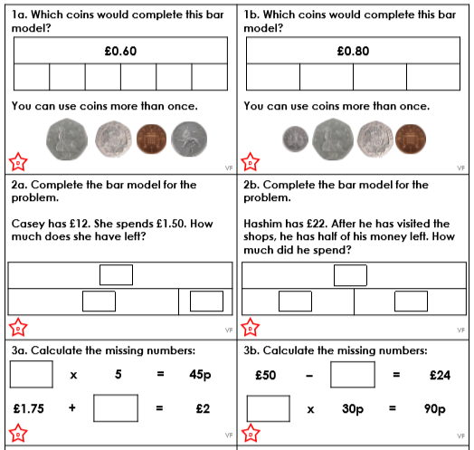
Task - clouds

Slide 29
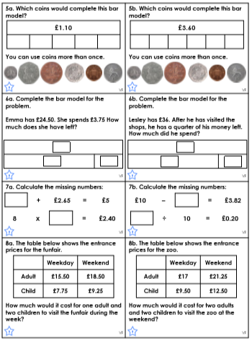
Task - Moons

Slide 30
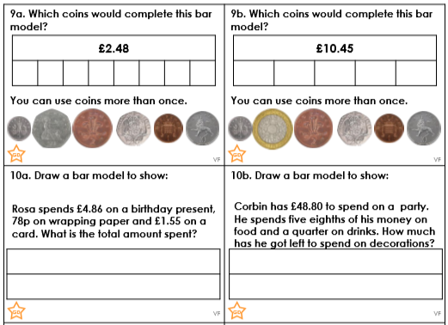
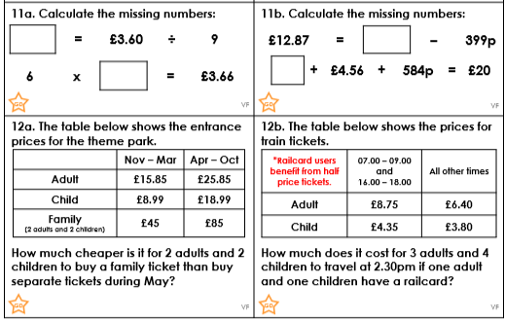
Task - Stars

Slide 31
Year 4 – Summer – Time
Lesson 3: Time- Hours, Minutes and Seconds

Slide 32
Introduction
Would you measure the following events in
hours, minutes or seconds?
How long you spend at school in a day
How long it takes to drive to the centre of London
The length of a TV show
How quickly you can do 10 jumping jacks

Slide 33
Introduction
Would you measure the following events in
hours, minutes or seconds?
How long you spend at school in a day hours
How long it takes to drive to the centre of London hours/minutes depending on where you live
The length of a TV show
minutes
How quickly you can do 10 jumping jacks
seconds

Slide 34
Varied Fluency 1
Complete the table
Hours | Minutes
1 hour 15 minutes
 | 95
2 hours 40 minutes
 | 185
4 hours 10 minutes

Slide 35
Varied Fluency 1
Complete the table
Hours | Minutes
1 hour 15 minutes | 75
1 hour 35 minutes | 95
2 hours 40 minutes | 160
3 hours 5 minutes | 185
4 hours 10 minutes | 250

Slide 36
Varied Fluency 2
Fill in <, > or = to make the statement correct.
2 minutes 20 seconds |  | 140 seconds

Slide 37
Varied Fluency 2
Fill in <, > or = to make the statement correct.
2 minutes 20 seconds | = | 140 seconds

Slide 38
Varied Fluency 3
Match the times together to find the odd one out.
1 hour 45 minutes
145 minutes
190 seconds
105 minutes
3 minutes 10 seconds

Slide 39
Varied Fluency 3
Match the times together to find the odd one out.
1 hour 45 minutes
odd one out
145 minutes
190 seconds
105 minutes
3 minutes 10 seconds

Slide 40
Varied Fluency 4
Which children were quicker in week 1?
Name | Week 1 | Week 2
Jamie | 2 hours 20 minutes | 150 minutes
Tami | 130 seconds | 2 minutes
Ahmed | 215 minutes | 3 hours 40 minutes

Slide 41
Varied Fluency 4
Which children were quicker in week 1?
Name | Week 1 | Week 2
Jamie | 2 hours 20 minutes | 150 minutes
Tami | 130 seconds | 2 minutes
Ahmed | 215 minutes | 3 hours 40 minutes

Slide 42
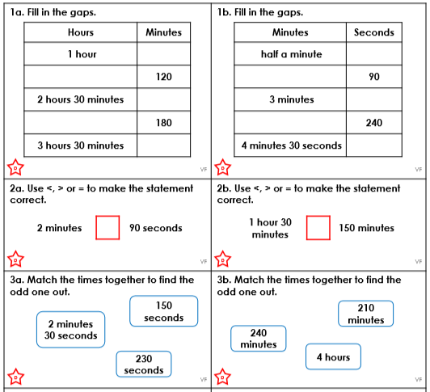
Task - clouds

Slide 43
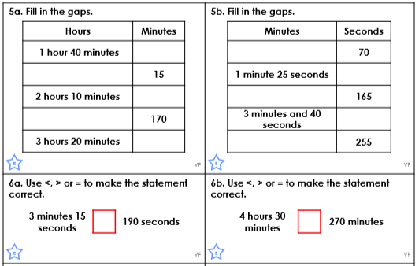
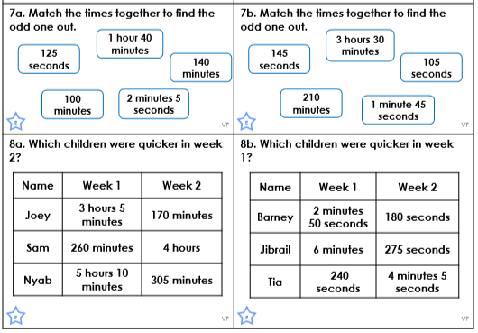
Task - Moons

Slide 44
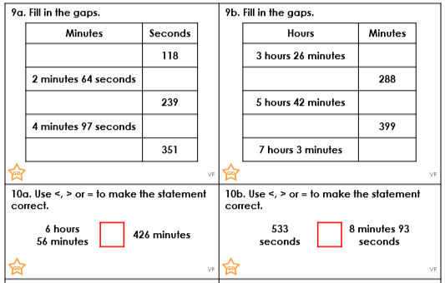
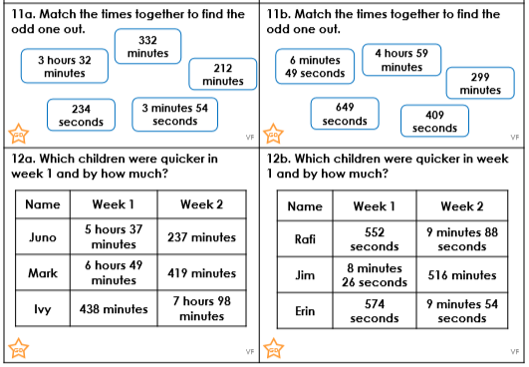
Task - Stars

Slide 45
Year 4 – Summer Block 3 – Time
Step 2: Years, Months, Weeks and Days

Slide 46
Introduction
Which months have the most days?
Which month has the fewest days?
How many months have 28 days?
How many days are in one year?
How many weeks are in two years?
How often do leap years occur? Which month gets an extra day in a leap year?

Slide 47
Introduction
Which months have the most days?
January, March, May, July, August, October and December
Which month has the fewest days?
February
How many months have 28 days?
All of them
How many days are in one year?
365
How many weeks are in two years?
104
How often do leap years occur?
Every four years Which month gets an extra day in a leap year?
February

Slide 48
Varied Fluency 1
Complete the statements.
There are |  | days in January.
There are |  | months in half a year.
There are |  | days in 5 weeks 3 days.

Slide 49
Varied Fluency 1
Complete the statements.
There are | 31 | days in January.
There are | 6 | months in half a year.
There are | 38 | days in 5 weeks 3 days.

Slide 50
Varied Fluency 2
Circle the true statement.
There are 17 days in 3 weeks.
There are 24 months in 2 years.
There are 50 weeks in 1 year.

Slide 51
Varied Fluency 2
Circle the true statement.
There are 17 days in 3 weeks.
There are 24 months in 2 years.
There are 50 weeks in 1 year.

Slide 52
Varied Fluency 3
Match the durations.
28 days
14 days
2 weeks
1 and a half years
18 months
4 weeks

Slide 53
Varied Fluency 3
Match the durations.
28 days
14 days
2 weeks
1 and a half years
18 months
4 weeks

Slide 54
Varied Fluency 4
Circle the longest duration.
1 month
3 days
2 weeks

Slide 55
Varied Fluency 4
Circle the longest duration.
1 month
3 days
2 weeks

Slide 56
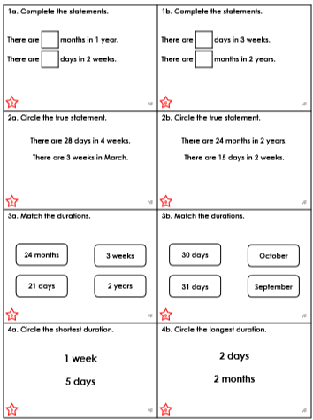
Task - clouds

Slide 57
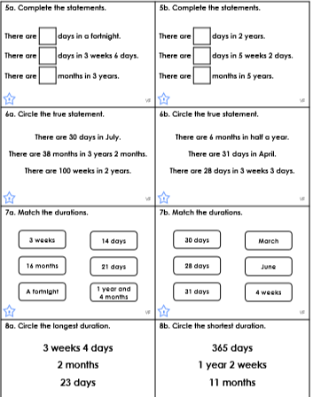
Task - Moons

Slide 58
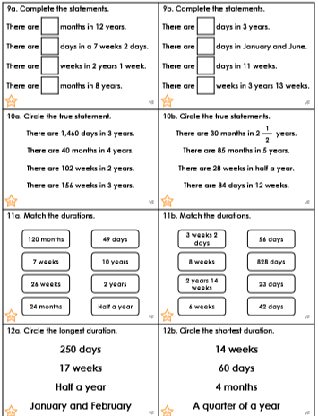
Task - Stars

Slide 59
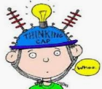
Lesson 5 – Mental Maths
Today you will continue to strengthen your mental arithmetic skills. In addition to this, please remember to do regular TT rockstars practise too. ☺

Slide 60
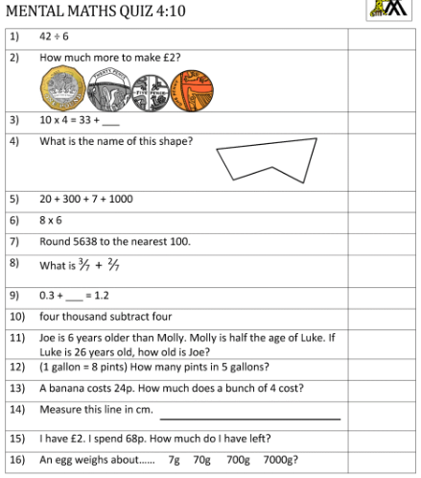
The mental maths worksheet is a great way of practising your number and maths skills.
The questions have been designed to practise a range of maths skills from number to geometry and measurement facts, including using time and money. For an extra challenge try to complete each question in 15-20seconds.

Slide 61
Another week complete! Well done you, we are so very
proud of you all! Enjoy the weekend year 4. We miss you!

