Slide 1
Year One Maths
WB: 04.05.20
Week 2

Slide 2
Parents/Carers,
Just a note to say first of all a massive thankyou for engaging in home learning with your children. We completely understand that these times are quite daunting and are so full of uncertainty. We will try our very best to keep these tasks as fun and as simple as we can, with minimal resourcing to help continue your children’s mathematical learning.
Just a couple of notes to help make these tasks easier to understand and bust some of the jargon:
Please do not feel pressured to complete all work set and feel free to ask us any questions you may have. We are always happy to help.
Stay Safe and healthy, we very much look forward to seeing you all!
Year One Team ☺
Term(s) | Explanation:
Layered learning grid (Clouds/Moons/Stars) | These are our challenge levels. We encourage children to choose the challenge they feel most confident with. Clouds being the first level and stars being the last.
Practical/practically | This is when the children use objects that they can physically manipulate (cubes/blocks/straws etc) to work out a problem.
Plenary | We use plenaries to summarise the learning. This normally consists of problem solving or reasoning to ensure they completely understood the task set.
Arithmetic | This is also known as mental maths- questions children may be able to work out in their heads at a speedy pace.

Slide 3
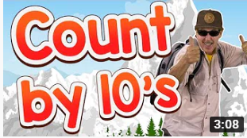
Monday 4th May 2020 04.05.20 Key Skill: I can count in 10’s
Starter:
Learn to count in 10’s with Jack Hartman!
https://www.youtube.com/watch?v=W8CEOlAOGas

Slide 4
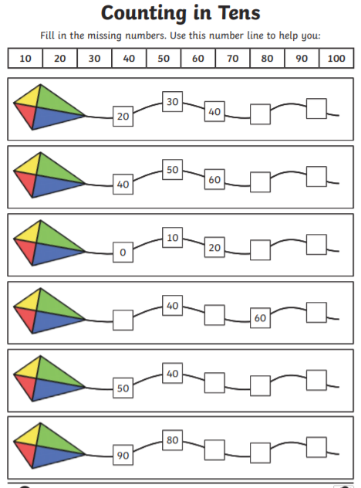
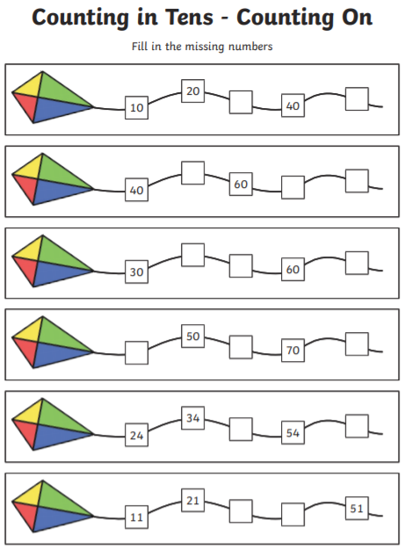
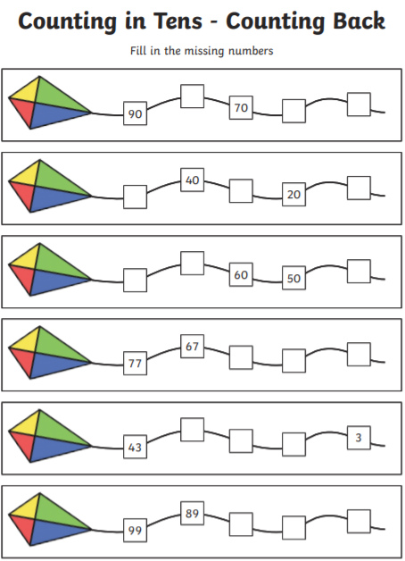
Monday 4th May 2020 04.05.20 Key Skill: I can count in 10’s
Task: You will need your exercise book and a pencil for this task.
Steps
Draw the kite in your books.
Have a go at filling in the missing numbers.
If you have chosen the stars, you are counting back. Use a hundred square to help you!

Slide 5
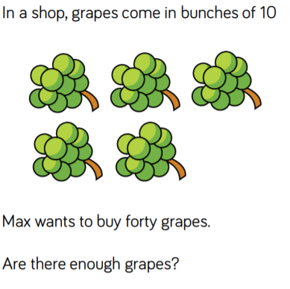
Monday 4th May 2020 04.05.20 Key Skill: I can count in 10’s
Plenary:

Slide 6
Tuesday 5th May 2020 05.05.20 Key Skill: I can make equal groups.
Starter:
Fill in the missing number bond to 20 in your books.
Work it out!
20+ ( ) = 20
19+ ( ) = 20
18+ ( ) = 20
17+ ( ) = 20
16+ ( ) = 20
15+ ( ) = 20
14+ ( ) = 20
13+ ( ) = 20
9) 12+ ( ) = 20
10) 11+ ( ) = 20
11) 10+ ( ) = 20
Work it out!
9+ ( ) = 20
8+ ( ) = 20
7+ ( ) = 20
6+ ( ) = 20
5+ ( ) = 20
4+ ( ) = 20
3+ ( ) = 20
2+ ( ) = 20
9) 1+ ( ) = 20
10) 0+ ( ) = 20

Slide 7
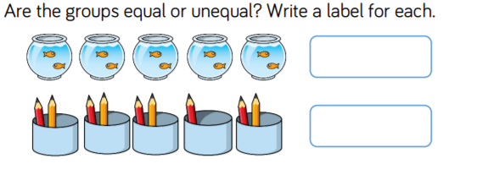
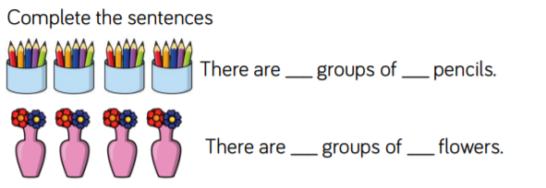
Tuesday 5th May 2020 05.05.20 Key Skill: I can make equal groups.
Task: You will need your exercise book, and a pencil for this task. Remember to write down the challenge you have chosen.
Steps
Clouds:
Draw the picture in your books and label whether it is equal or unequal.
Moons:
Draw the pictures in your book and complete the sentences.
Stars:
Draw the picture in your books and complete the equal groups.
Remember equal means the same!

Slide 8
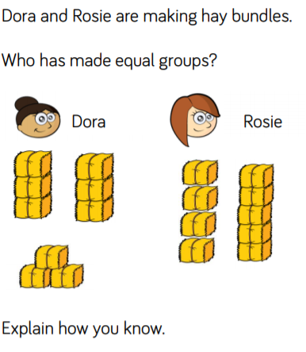
Tuesday 5th May 2020 05.05.20 Key Skill: I can make equal groups.
Plenary:

Slide 9
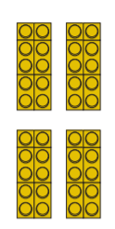
Wednesday 6th May 2020 06.05.20 Key Skill: I can add equal groups.
Starter:
With a grown up, complete the following sentence:
There are _______ equal groups of _______.
Teaching Point:
When making equal groups you can record them as repeated addition. So for the picture above, you could write it as 10+10+10+10. They mean the same thing ☺

Slide 10
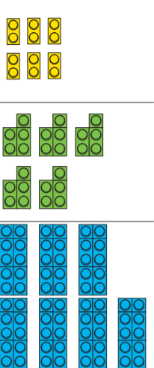
Wednesday 6th May 2020 06.05.20 Key Skill: I can add equal groups.
Task: You will need your exercise book, and a pencil for this task. Remember to write down the challenge you have chosen.
Steps
Choose your challenge.
Draw the image in your book.
Write it as a repeated addition.
Remember, count the groups carefully!

Slide 11
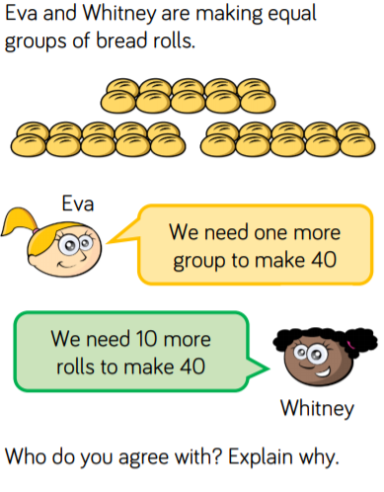
Wednesday 6th May 2020 06.05.20 Key Skill: I can add equal groups.
Plenary:
Discuss the following problem with a grown up.

Slide 12
Thursday 7th May 2020 07.05.20 Key Skill: I can double numbers within 20.
Starter:
What does double mean? Discuss with your grown up.
Teaching Point:
Doubling is when you add the same two numbers together. For example: Double 3 is the same as 3 + 3. When you add 3 and 3 you get 6, so double 3 is 6 ☺

Slide 13
Thursday 7th May 2020 07.05.20 Key Skill: I can double numbers within 20.
Task: You will need your exercise book, a pencil and two crayons for this task. Remember to write down the challenge you have chosen.
Steps
Choose your challenge.
Write down the number that you are doubling.
Draw your double using different coloured dots.
Count the dots.
Write your answer.
Eg:
2 Double 2 is 4.
Clouds | Moons | Stars
2 | 8 | 15
1 | 7 | 19
3 | 10 | 20
4 | 9 | 17
5 | 13 | 16
6 | 12 | 18

Slide 14
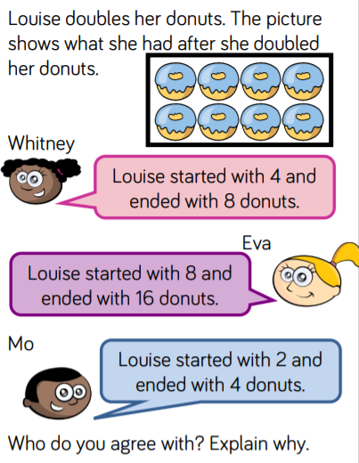
Thursday 7th May 2020 07.05.20 Key Skill: I can double numbers within 20.
Plenary:

Slide 15
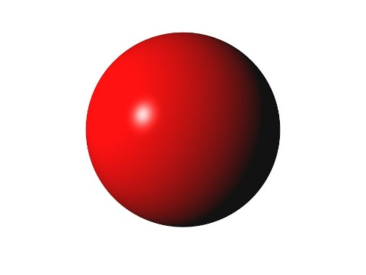
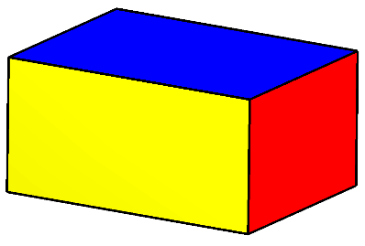
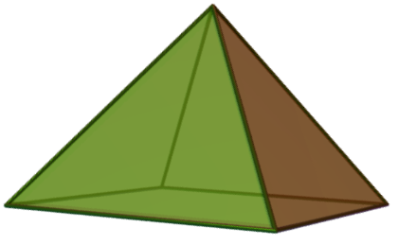
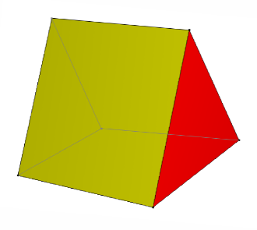
Friday 8th May 2020 08.05.20 Key Skill: I can make equal groups.
Starter:
Tell your grown up the name of these 3D shapes.
Cube
Cuboid
Sphere
Pyramid
Prism

Slide 16
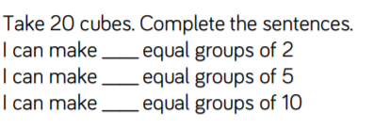
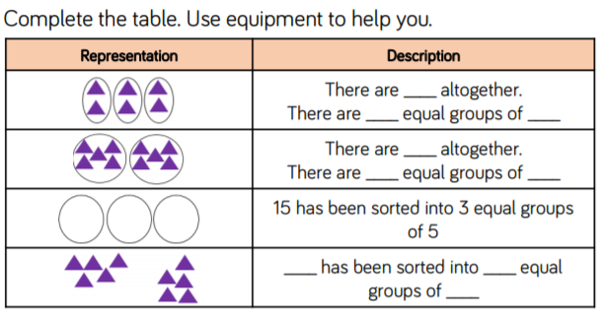
Friday 8th May 2020 08.05.20 Key Skill: I can make equal groups.
Task: You will need your exercise book and a pencil for this task. Remember to write down the challenge you have chosen.
Steps
Clouds
-Draw the group mittens in your book.
-Underneath, draw them in equal groups of 2.
Moons
-Using an object of your choice, fill in the questions in your book.
Stars
-Copy the table in your books.
-Complete the missing parts.

Slide 17
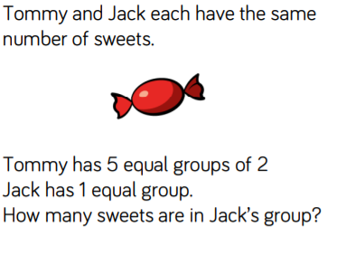
Friday 8th May 2020 08.05.20 Key Skill: I can make equal groups.
Plenary (Work out in your books):

Slide 18
Our lovely children,
We are so sad to not be able to teach you this in our classrooms right now, but we just want you to know that we are so very proud of you for continuing that hard work at home. Each and every single one of you are amazing and we are very lucky teachers to have you as our students.
Please keep smiling and being the amazing children that you are.
Take care and stay safe.
Hope to see you very soon,
Miss Masterson, Mrs Gray and Mrs Davis. ☺

